Slide 1




Project: Human Respiration Detection Under Interference via mmWave
Presenter: 吉辰卿 华羽霄
SID: 12332152 12010508

Slide 2
01.Intro & Background
The ability to accurately and reliably detect respiratory patterns has long been a crucial aspect of healthcare monitoring, sleep analysis, and physical activity tracking.
Traditionally, respiration detection has relied on the use of sensors or wearable devices, which often impose constraints on the individual’s freedom of movement and may lead to discomfort or inconvenience.
Millimeter waves have shorter wavelengths, enabling higher precision in detecting subtle respiratory movements.
In general, there are two types of interference:
Static Environmental Interference: Environmental interference encompasses external factors that potentially compromise the accuracy and reliability of a measurement or detection process, such as the presence of reflected signals from the static environment.
Motion Interference: The interference caused by human motion is induced through random human motion around the detected target in the surrounding area during respiration detection.

Slide 3
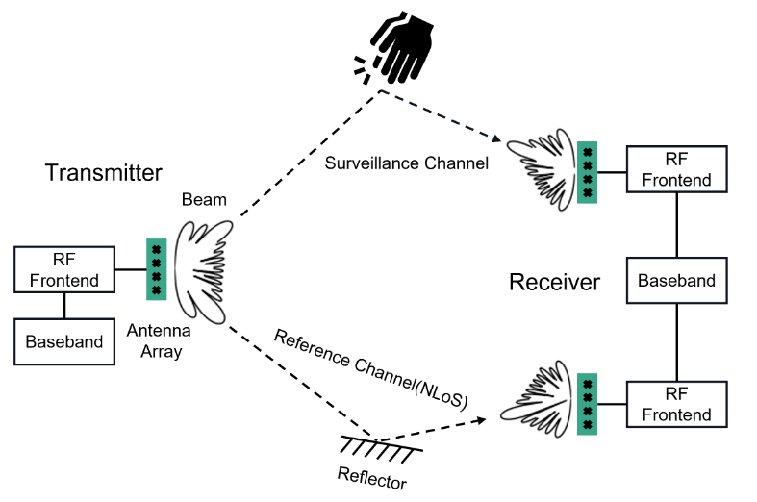
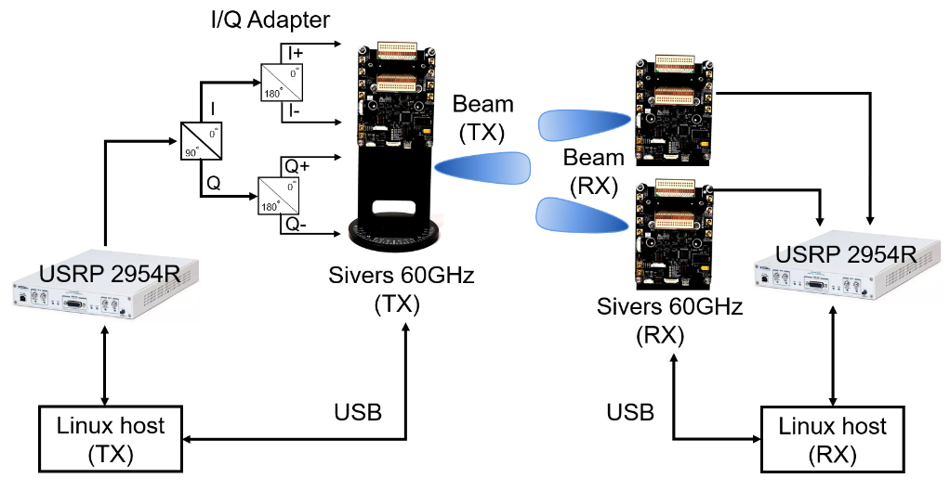
02. Previous System
Gesture Recognition via passive mmWave Sensing System^{[1]}
Fig. Illustration of the passive gesture recognition system based on mmWave
[1] Li, J., Yu, C., Luo, Y., Sun, Y., & Wang, R. (2022). Passive Motion Detection via mmWave Communication System.

Slide 4
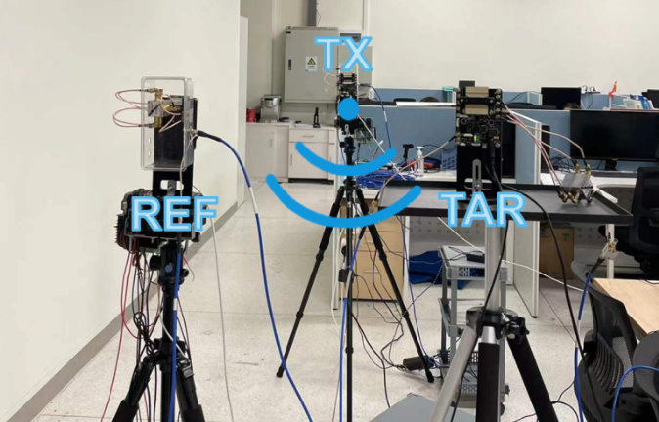
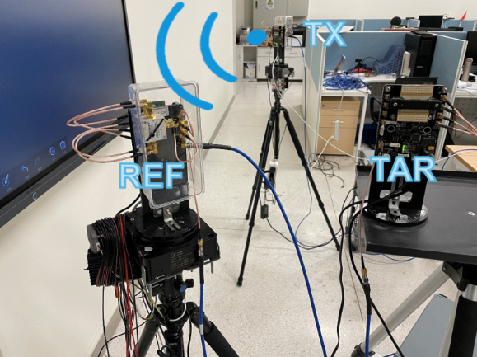
02. Previous System
LOS Scenario
NLOS Scenario
[1] Li, J., Yu, C., Luo, Y., Sun, Y., & Wang, R. (2022). Passive Motion Detection via mmWave Communication System.

Slide 5
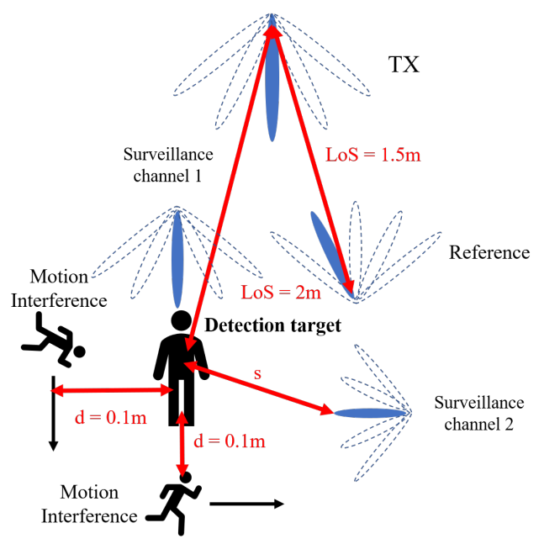
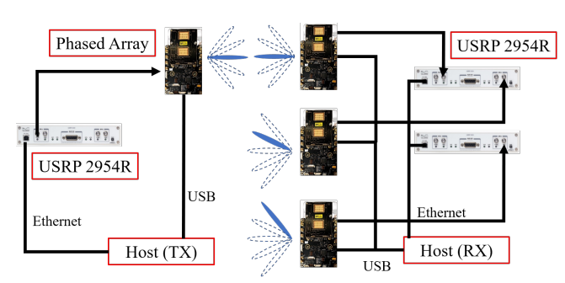
03.Expected System
Human Respiration Sensing System
Add a new millimeter wave communication link
Anti-interference?

Slide 6
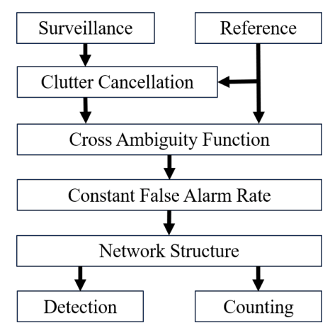
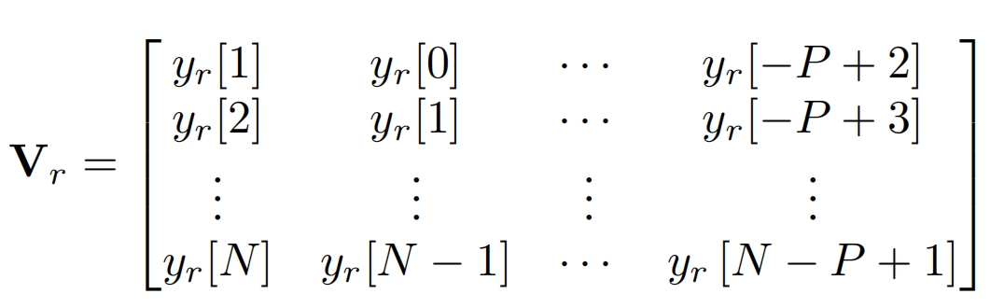



04. Algorithm Analysis
监视信道杂波消除--最小二乘法估计^{[2]}
V_{r} is the matrix of delayed reference signal of the reference channel
V_{s} is the matrix of the surveillance channel
Fit the delay coefficient by the least square method
[2]Tan D K P, Sun H, Lu Y, et al. Passive radar using global system for mobile communication signal: theory, implementation and measurements[J]. IEE Proceedings-Radar, Sonar and Navigation, 2005, 152(3): 116-123.

Slide 7
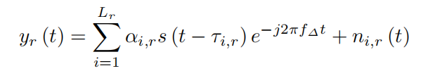
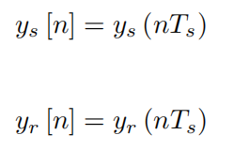
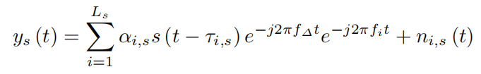
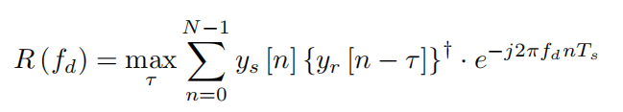
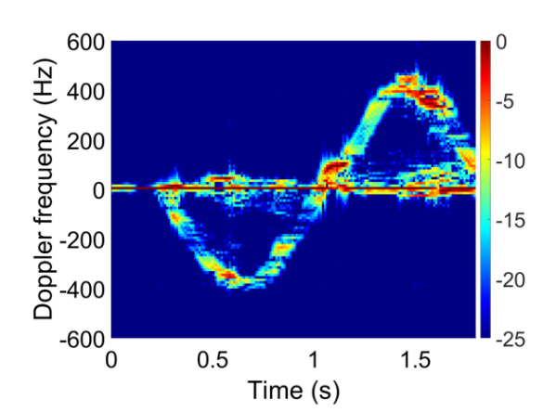
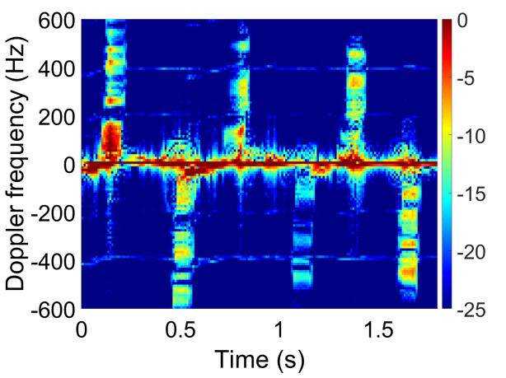
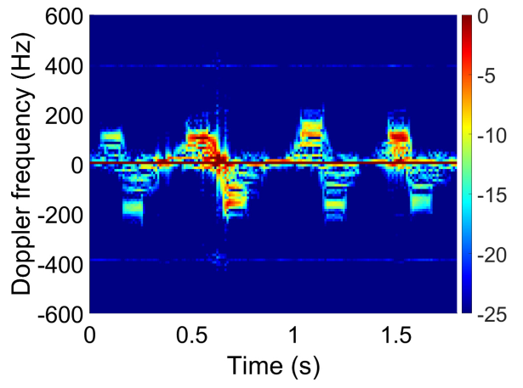
04. Algorithm Analysis
互相关模糊函数(CAF)得到时间-多普勒频偏谱图^{[1]}
采样
滑动时间窗口+互相关模糊函数得到时间-多普勒图
Fig. Different Gesture Spectrograms obtained: pushing hand, beckoned and rubbing finger
(From left to right)

Slide 8


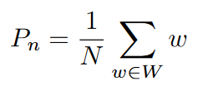

04. Algorithm Analysis
二维恒虚警检测算法(2D-CFAR)处理CAF后得到的频谱图：
检测单元：需要与阈值进行比较的单元被称为检测单元(CUT)。
训练单元：CUT周围同等数量的单元被用来计算背景噪声功率，这些单元被称为训练单元。
守护单元：在CUT和训练单元之间有几个单元不参与背景噪声功率的计算，这些单元被称为保护单元。
阈值: β = α*P_{n} 由背景噪声功率 P_{n} 和阈值因子 α 决定。
背景噪声功率：
阈值系数 α 由预先确定的虚警率决定：

Slide 9
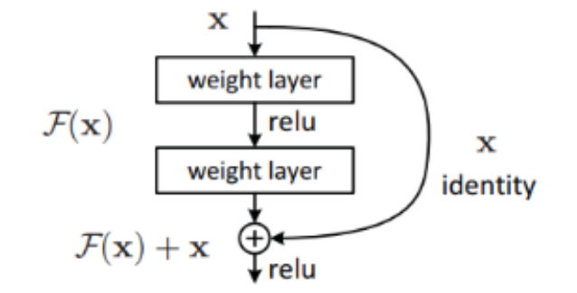
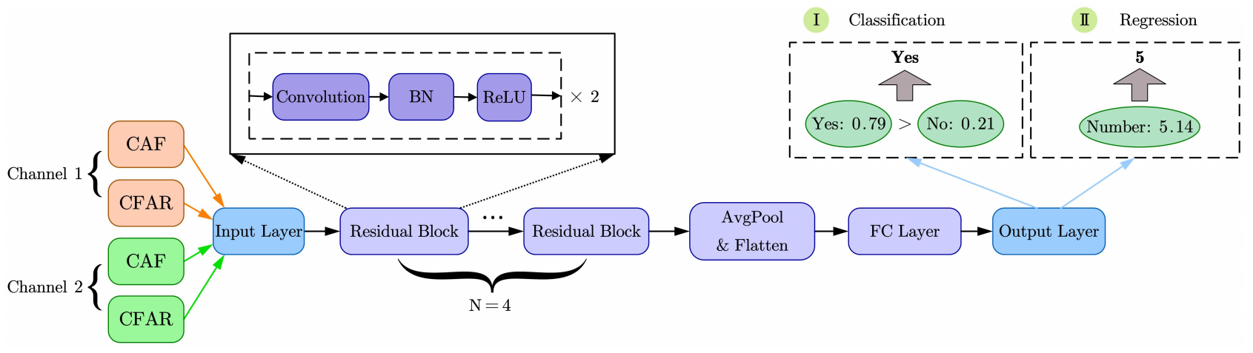
04. Algorithm Analysis
可能需要的神经网络结构: (Resnet ?)

Slide 10
05. Future Plan
基于实验室已有的毫米波被动雷达平台进行实验，使用上面提到的信号处理算法得出处理后的时间-多普勒图像(CAF依据实验室之前的Work实现，基于最小二乘法的杂波消除算法需要自己研究进行实现)。
将接收到的两个监视信道的时间-多普勒图像数据馈入残差神经网络，得到分类(是否有人在呼吸)以及不同呼吸频率的计数结果。
探究当实验者周围有其他人干扰时，我们的系统检测准确率如何。
探究分类准确率随感知时间的关系。
探究传感分类准确率与被测者距最近的监视信道的距离之间的关系。

Slide 11
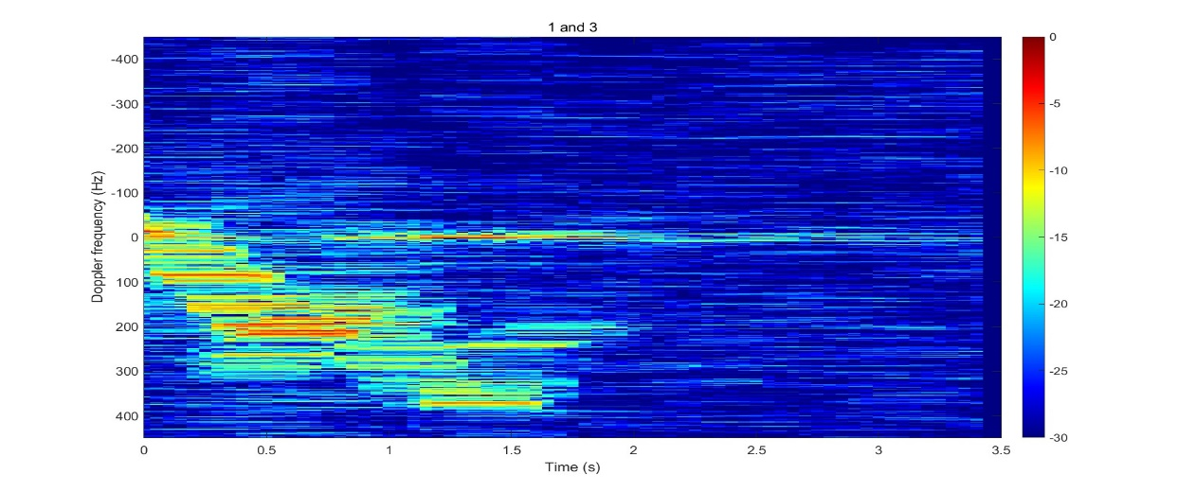
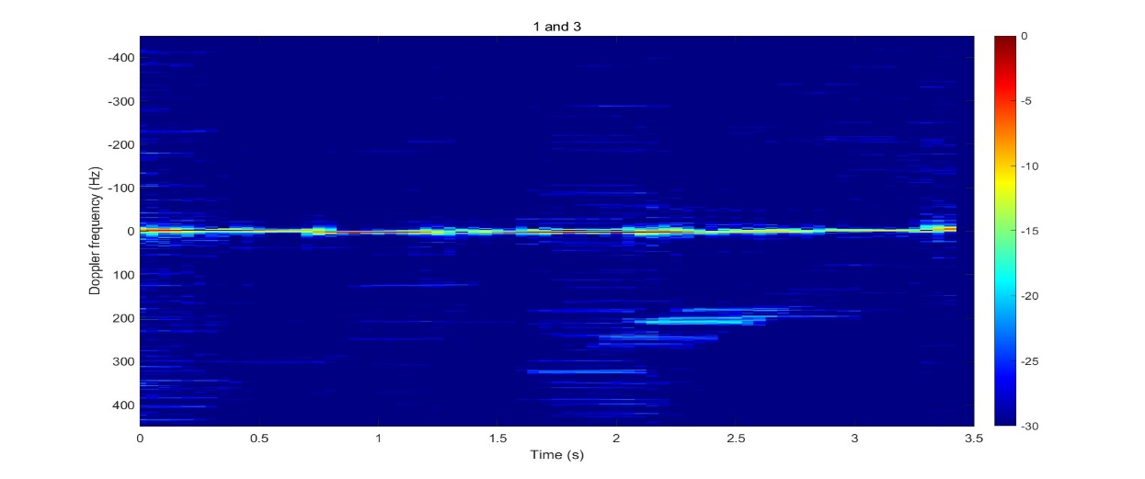
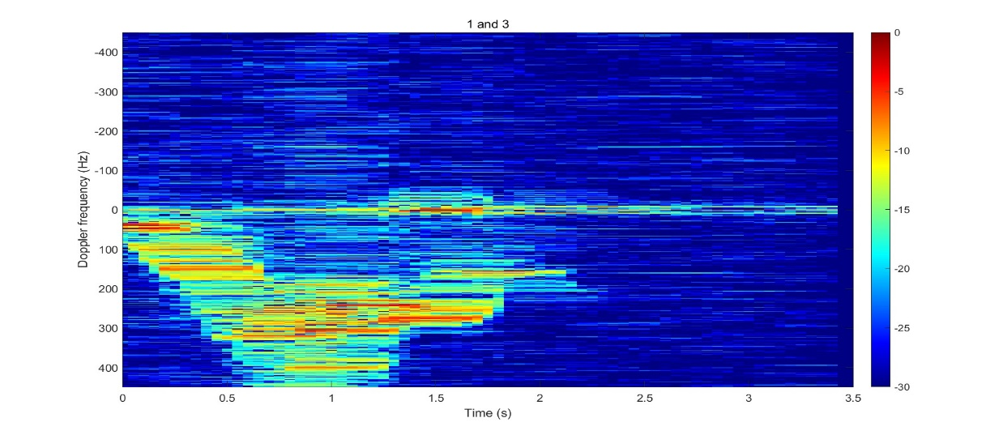
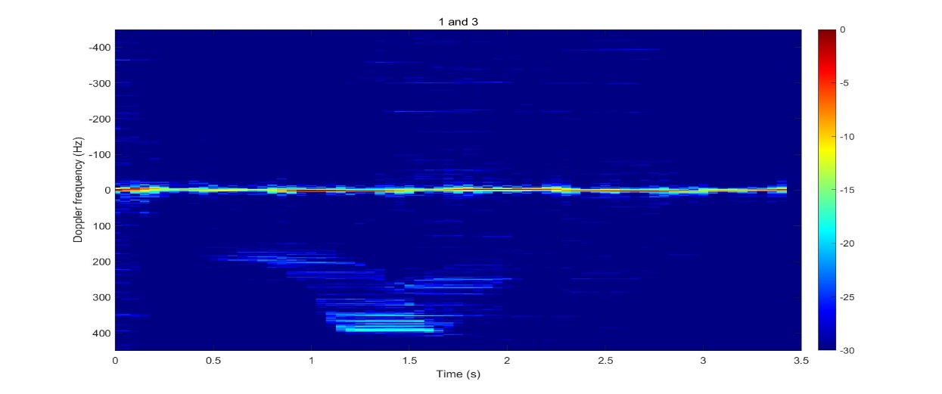
CAF之后
1. 监测机正对着测试者的呼吸，多普勒信号最强。
2. 归一化后，行走呼吸的图像中，行走信息被丢弃。
未加杂波过滤和恒虚警率
纯行走
行走呼吸
-40到-25dB
-10到-5dB

Slide 12
后续工作
实验内容：纯呼吸、呼吸行走、纯行走、空
研究FFT后加上杂波消除以及虚恒警的效果是否能达到预期
研究是否能否直接通过数学公式推导，如果否需要引入神经网络吗？（呼吸信号集中在0附近，不够明显）

Slide 13

Thanks for watching！
Notes:
请各位专家老师批评指正！

Slide 14
Q&A
Notes:
请各位专家老师批评指正！

